Slide 1

National University of Computer and Emerging Sciences
Variational Autoencoders
AI-5004 Adv. Topics in Generative AI
Dr. Muhammad Nouman Noor
Department of Artificial Intelligence and Data Science

Slide 2
Goals
Today’s Lecture
Variational autoencoder (VAE)
Denoising Autoencoders (DAE)

Slide 3
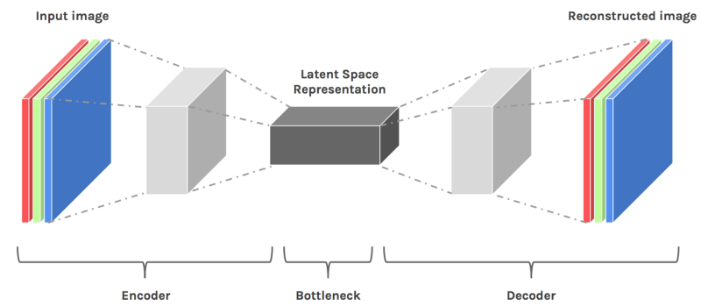
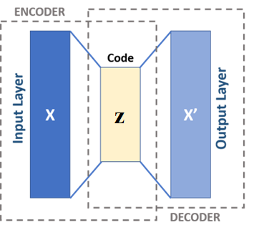
Autoencoders
Autoencoders are simple neural network architectures.
They basically do compression on data and reconstruct the original data.

Slide 4
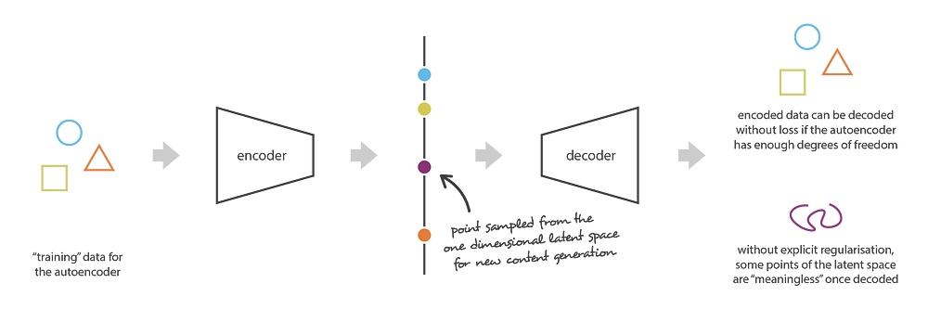
Variational Autoencoders (VAE)
A variational autoencoder (VAE) is a type of neural network that can generate new content, detect anomalies, and remove noise.
VAEs combine two types of neural networks:
Encoder: For encoding raw data into a latent space
Decoder: For transforming the latent representations into new content.

Slide 5
Variational Autoencoders (VAE)
A variational autoencoder: :Latent space has good properties that enable the generative process.
It is designed to handle the issue of generating new instances that are varied yet still resemble the input data.
Instead of encoding an input as a single point, we encode it as a distribution over the latent space.

Slide 6
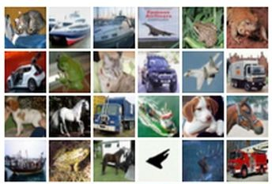
Some background first: Autoencoders
Unsupervised approach for learning a lower-dimensional feature representation from unlabeled training data
z usually smaller than x
(dimensionality reduction)
Originally: Linear + nonlinearity (sigmoid)
Later: Deep, fully-connected
Later: ReLU CNN
Q: Why dimensionality reduction?
A: Want features to capture meaningful factors of variation in data
Features
Encoder
Input data

Slide 7
Some background first: Autoencoders
How to learn this feature representation?
Train such that features can be used to reconstruct original data “Autoencoding” - encoding itself
Originally: Linear +
nonlinearity (sigmoid)
Later: Deep, fully-connected
Later: ReLU CNN (upconv)
Reconstructed input data
Decoder
Features
Encoder
Input data

Slide 8
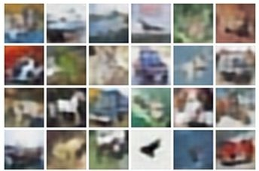
Some background first: Autoencoders
Reconstructed data
How to learn this feature representation?
Train such that features can be used to reconstruct original data “Autoencoding” - encoding itself
Reconstructed input data
Encoder: 4-layer conv
Decoder: 4-layer upconv
Decoder
Input data
Features
Encoder
Input data

Slide 9
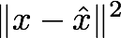
Some background first: Autoencoders
Reconstructed data
Train such that features
can be used to reconstruct original data
L2 Loss function:
Decoder res
 | Encoder
Reconstructed input data
Encoder: 4-layer conv
Decoder: 4-layer upconv
Input data
Featu
Input data
Lecture 13 -

Slide 10
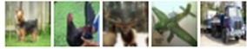
Some background first: Autoencoders
Loss function (Softmax, etc)
bird
plane
dog
deer
truck
Predicted Label
Fine-tune encoder jointly with classifier
Train for final task (sometimes with small data)
Classifier
Encoder can be used to initialize a supervised model
Features
Encoder
Input data

Slide 11
Some background first: Autoencoders
Autoencoders can reconstruct data, and can learn features to initialize a supervised model
Reconstructed input data
Features capture factors of variation in training data. Can we generate new images from an autoencoder?
Decoder
Features
Encoder
Input data
Lecture 13 -

Slide 12
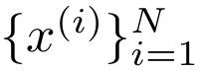
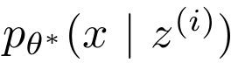
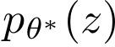
Variational Autoencoders
Probabilistic spin on autoencoders - will let us sample from the model to generate data!
Assume training data is generated from underlying unobserved (latent) representation z
Intuition (remember from autoencoders!): x is an image, z is latent factors used to generate x: attributes, orientation, etc.
Sample from true conditional
Sample from true prior
Kingma and Welling, “Auto-Encoding Variational Bayes”, ICLR 2014

Slide 13
Variational Autoencoders
We want to estimate the true parameters of this generative model.
Sample from true conditional
How should we represent this model?
Choose prior p(z) to be simple, e.g. Gaussian.
Conditional p(x|z) is complex (generates image) => represent with neural network
Decoder network
Sample from true prior
Kingma and Welling, “Auto-Encoding Variational Bayes”, ICLR 2014

Slide 14
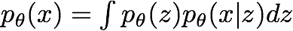
Variational Autoencoders
We want to estimate the true parameters of this generative model.
Sample from true conditional
How to train the model?
Learn model parameters to maximize likelihood of training data
Decoder network
Sample from true prior
Kingma and Welling, “Auto-Encoding Variational Bayes”, ICLR 2014

Slide 15
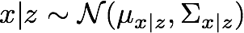
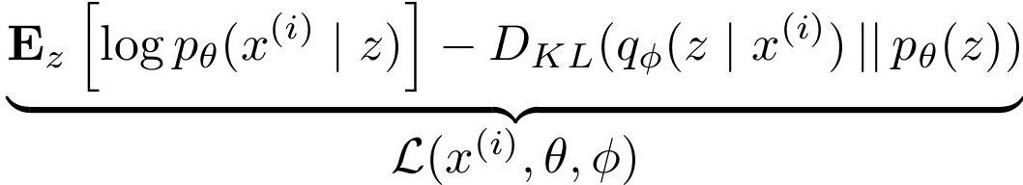
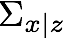
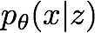
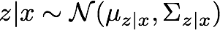
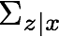
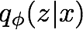
Variational Autoencoders
Putting it all together: maximizing the likelihood lower bound
Maximize
likelihood of original input being reconstructed
Sample x|z from
Decoder network
Kulback-Leibler Divergence
Sample z from
Make approximate posterior distribution close to prior
Encoder network
For every minibatch of input data: compute this forward pass, and then backprop!
Input Data
Lecture 13 -

Slide 16
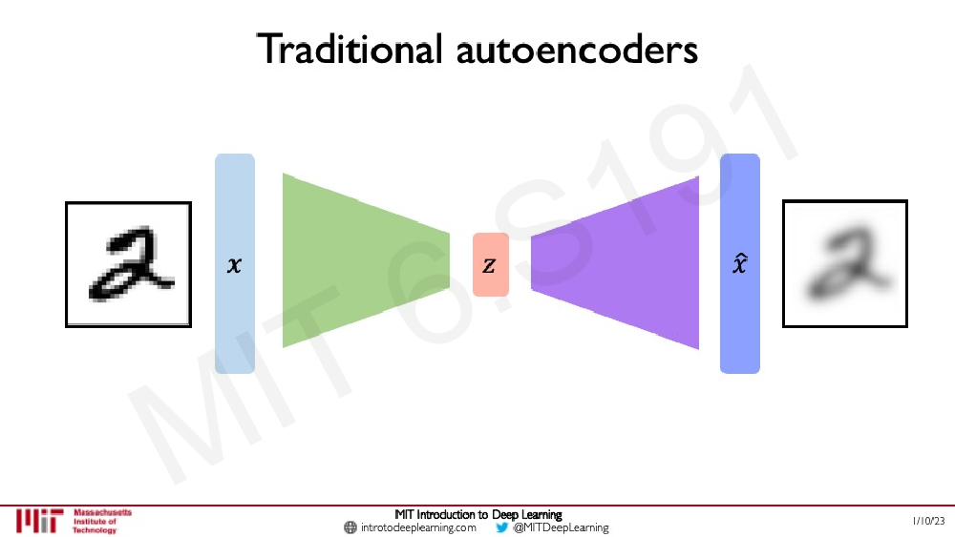

Slide 17
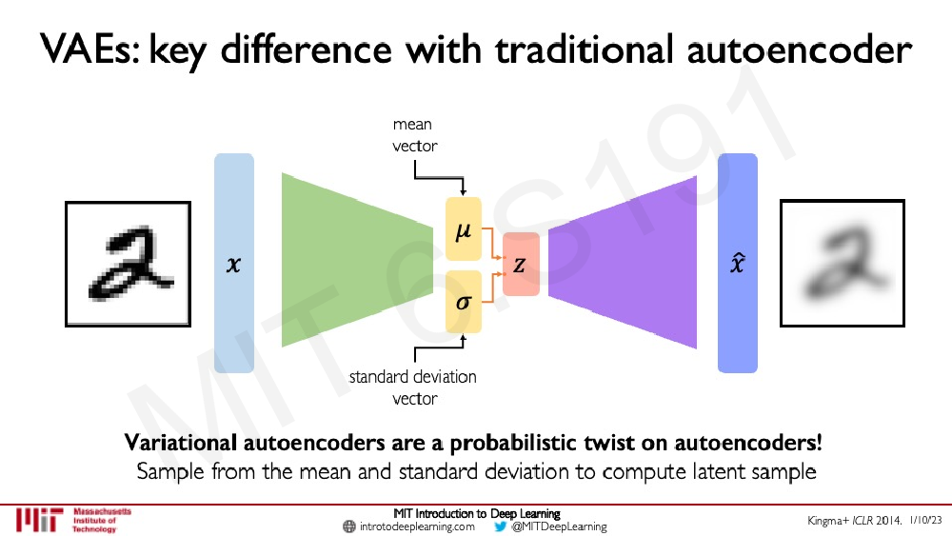

Slide 18
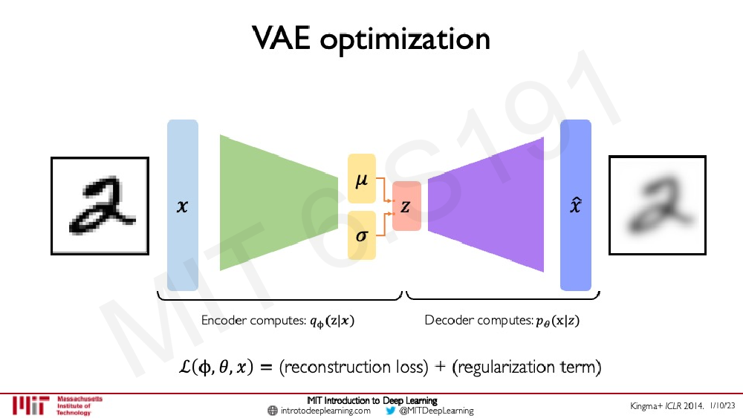

Slide 19
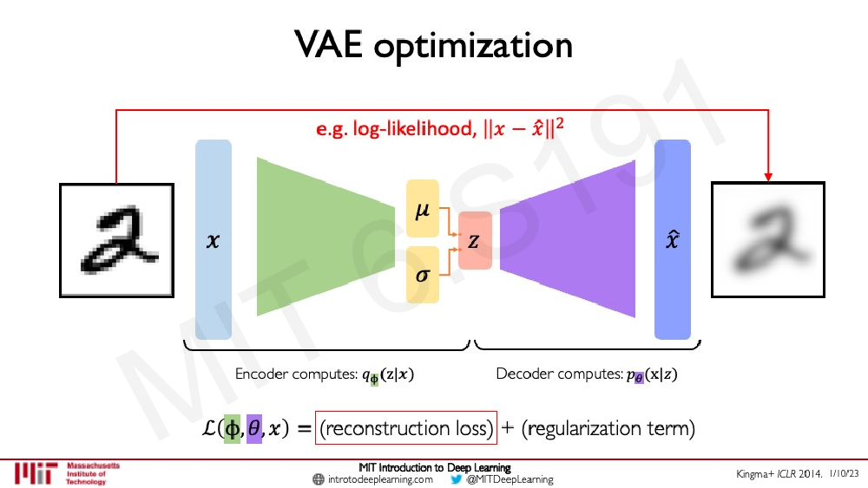

Slide 20
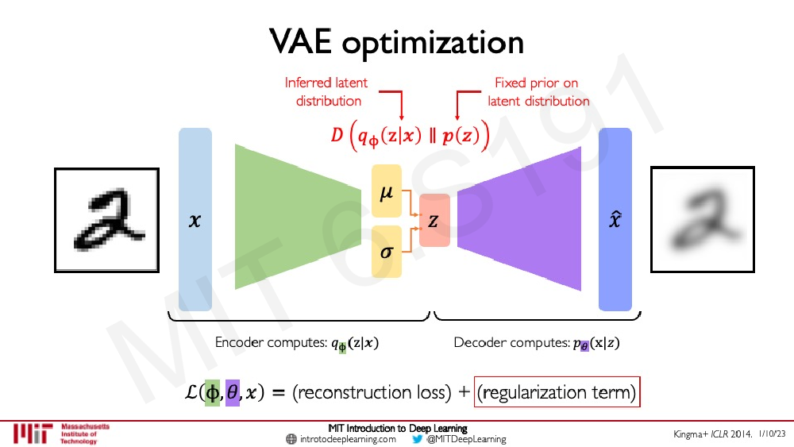

Slide 21
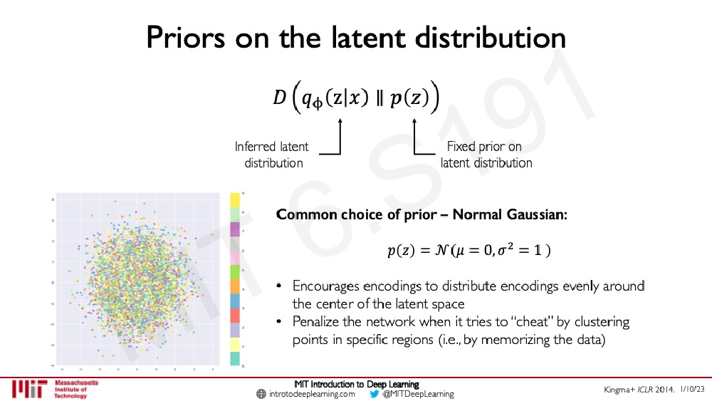

Slide 22
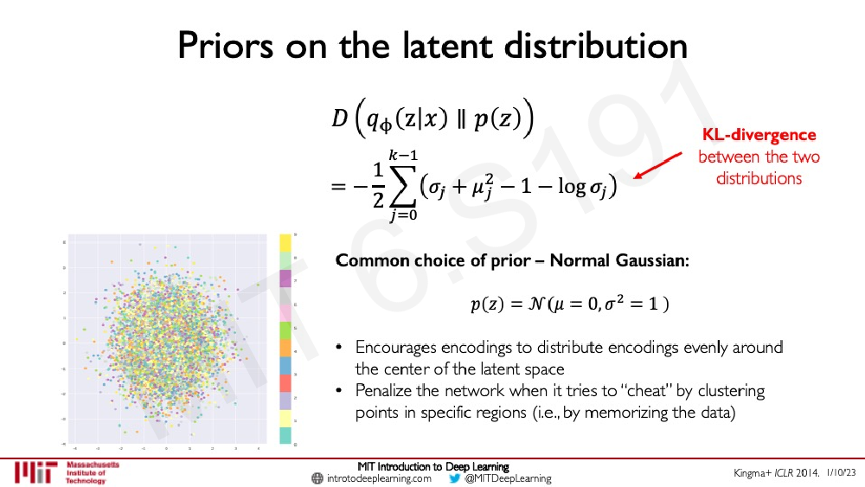

Slide 23
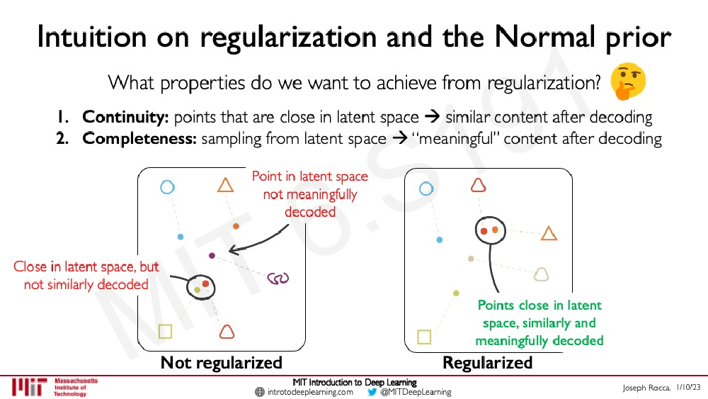

Slide 24
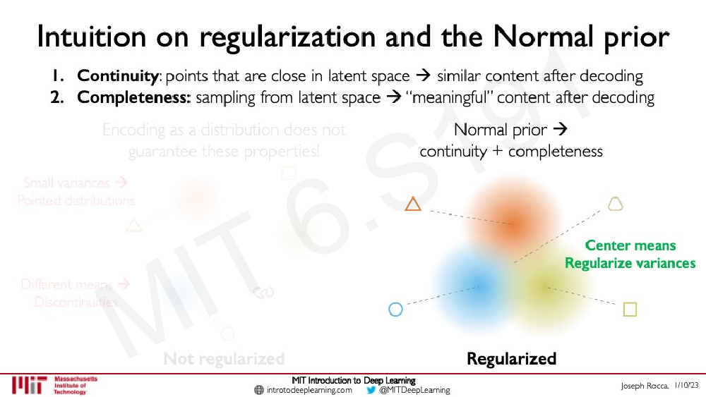

Slide 25
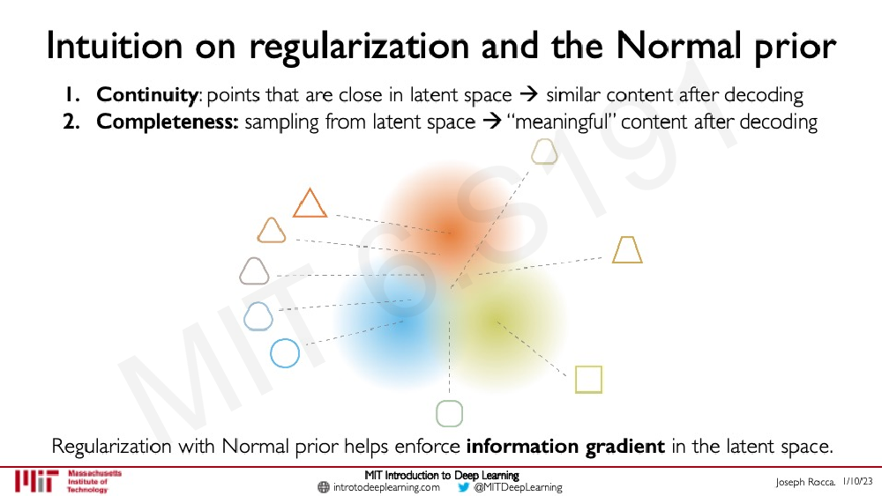

Slide 26
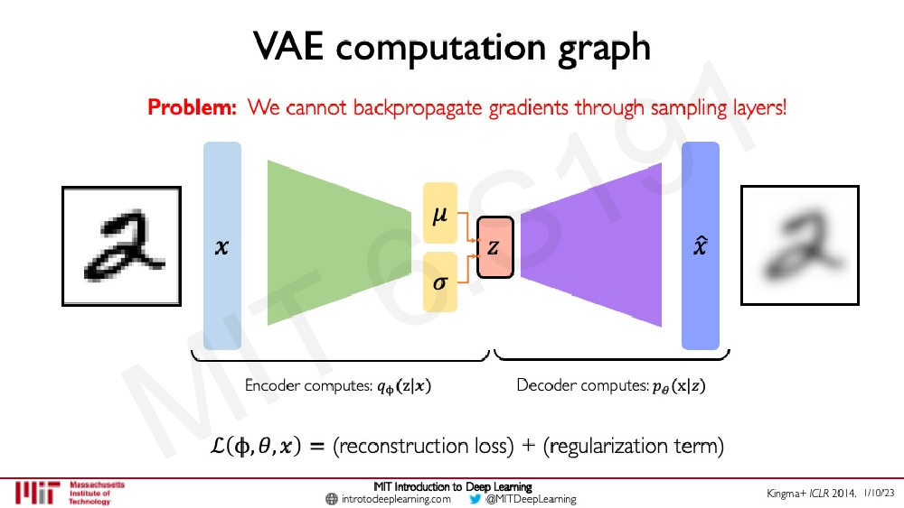

Slide 27
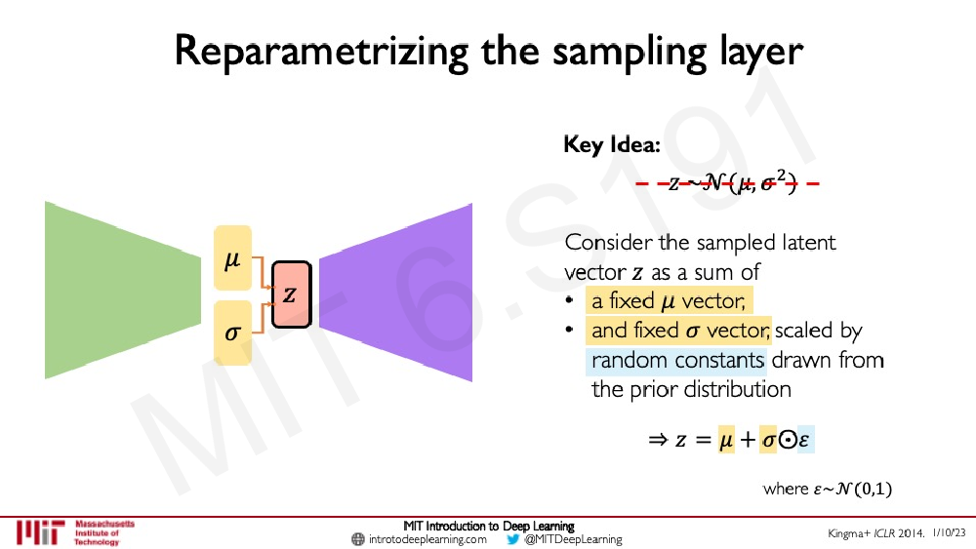

Slide 28
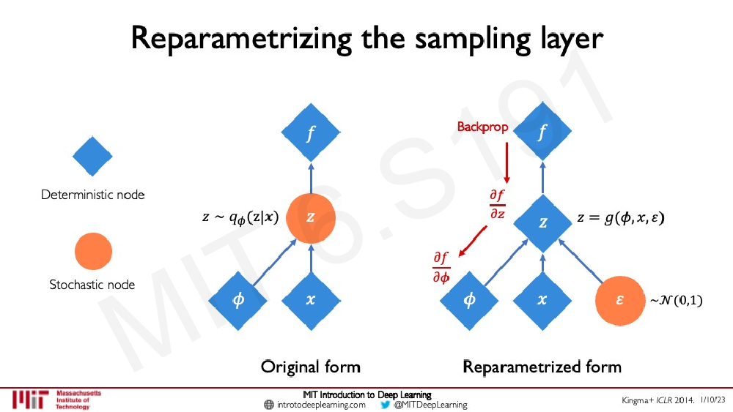

Slide 29
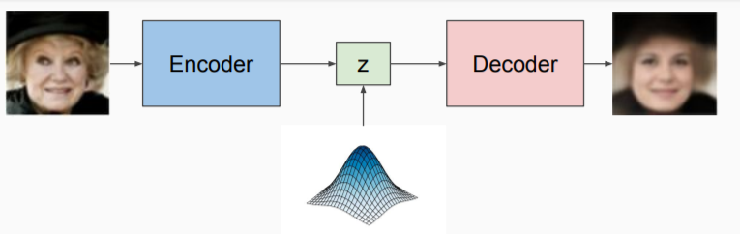
Variational Autoencoders
Try to understand the probability distribution of the input data

Slide 30
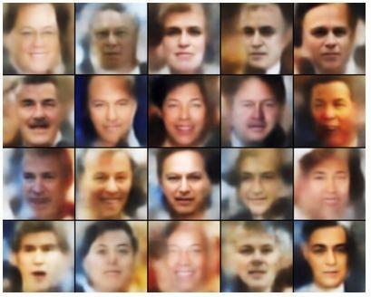
Variational Autoencoder Likelihood
Labeled Faces in the Wild

Slide 31
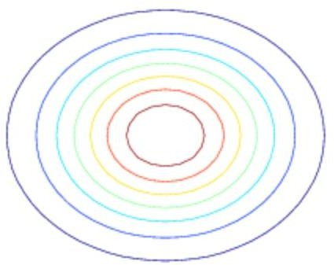
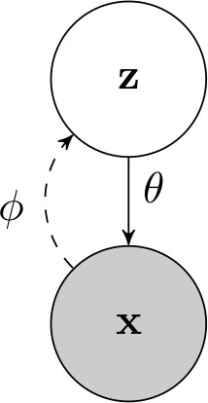
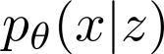
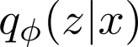
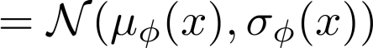
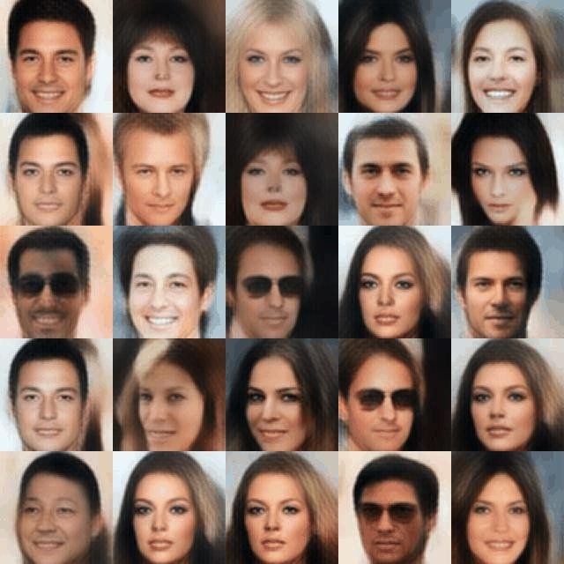
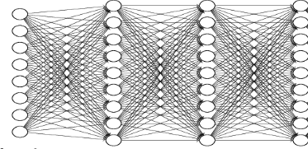
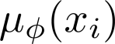
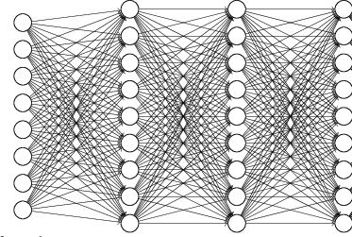
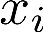
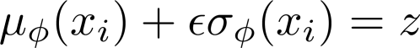
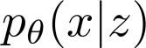
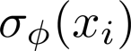
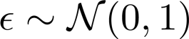
The variational autoencoder

Slide 32
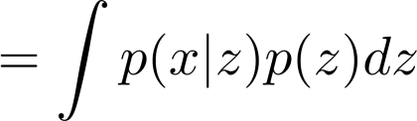
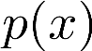
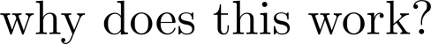



Using the variational autoencoder

Slide 33


















VAEs with convolutions
64x64x3
30x30x32
14x14x64
6x6x128
256
256
5x5x32 conv stride 2
3x3x64 conv stride 2
3x3x128
conv
stride 2
1024
256
1024
transpose convolutions
(independent) mean and
variance for each pixel
256

Slide 34




VAEs in practice
Common issue: very tempting for VAEs (especially conditional VAEs) to ignore the latent codes, or generate poor samples
Problem 1: latent code is ignored
Problem 2: latent code is not compressed
what does this look like?
blurry “average” image
when reconstructing
what does this look like?
garbage images
when sampling
too low
too high
need to control this quantity
carefully to get good results!

Slide 35

VAEs in practice
Problem 1: latent code is ignored
too low
Problem 2: latent code is not compressed
too high
need to control this quantity carefully to get good results!
multiplier to adjust regularizer strength

Slide 36
Conditional Variational Autoencoders (CVAEs)
Conditional Variational Autoencoders (CVAEs) can generate data conditioned on certain some additional information
For example: labels or other data characteristics such as categories.
CVAEs can generate data samples that possess specific desired properties.

Slide 37








Conditional Variational Autoencoders (CVAEs)

Slide 38
Conditional Variational Autoencoders (CVAEs)
Image Generation: Generating images of specific classes, styles, or attributes (e.g., generating images of faces with specific emotions).
Text Generation: Producing sentences or paragraphs conditioned on certain themes, sentiments, or keywords.
Recommendation Systems: Generating items or content tailored to individual users' preferences or contexts.

Slide 39
Denoising Autoencoders
Variant of autoencoders
These are neural networks designed to learn efficient representations (encodings) of the input data
Typically used for the purpose of dimensionality reduction or feature learning.
Denoising autoencoders are trained to reconstruct the original input from a corrupted input.

Slide 40
Denoising Autoencoders

Slide 41
Denoising Autoencoders

Slide 42






Denoising Autoencoders
0
1
2
3 9
Task: Hand-written digit recognition
|x_{i}| = 784 = 28 × 28
28*28
Figure: Basic approach(we use raw data as input features)
Figure: MNIST Data

Slide 43






xˆ_{i} ∈ R⁷⁸⁴
Denoising Autoencoders
Task: Hand-written digit recognition
h ∈ R^{d}
|x_{i}| = 784 = 28 × 28
Figure: MNIST Data
Figure: AE approach (first learn important characteristics of data)

Slide 44

Task: Hand-written digit recognition
Denoising Autoencoders
0
1
2
3 9
h ∈ R^{d}
|x_{i}| = 784 = 28 × 28
Figure: MNIST Data
Figure: AE approach (and then train a classifier on top of this hidden representation)

Slide 45



Figure: Vanilla AE (No noise)
Denoising Autoencoders
Figure: 25% Denoising AE (q=0.25)
Figure: 50% Denoising AE (q=0.5)
The vanilla AE does not learn many meaningful patterns
The hidden neurons of the denoising AEs seem to act like pen-stroke detectors (for example, in the highlighted neuron the black region is a stroke that you would expect in a ’0’ or a ’2’ or a ’3’ or a ’8’ or a ’9’)
As the noise increases the filters become more wide because the neuron has to rely on more adjacent pixels to feel confident about a stroke

Slide 46



Denoising Autoencoders
Figure: AE filters
Figure: Regularized filters (Weight decay)
Figure: Data
The hidden neurons essentially behave like edge detectors PCA does not give such edge detectors

Slide 47
References
Lecture notes from Fei-Fei, Stanford University, Dr. Sergey

Slide 48
Thank You ☺

